Slide 1
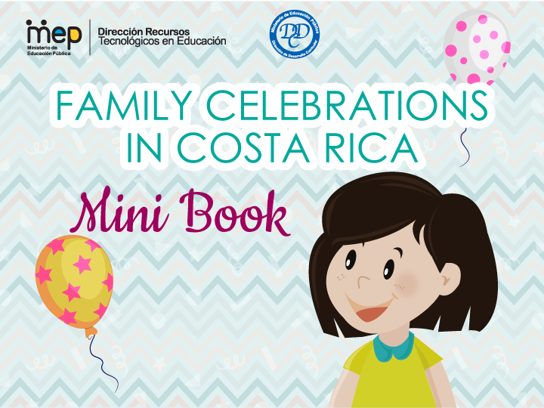

Slide 2

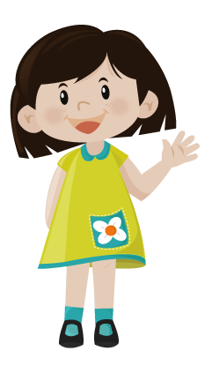
Hello! My name is Amanda. My tita Ana made this family celebration´s mini book for me. Let´s read.
How do my families celebrate together?.

Slide 3
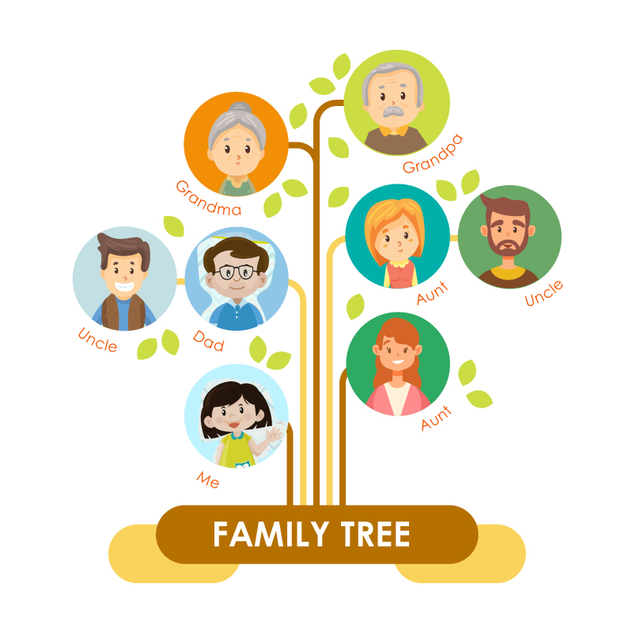
This is tita Ana´s family

Slide 4
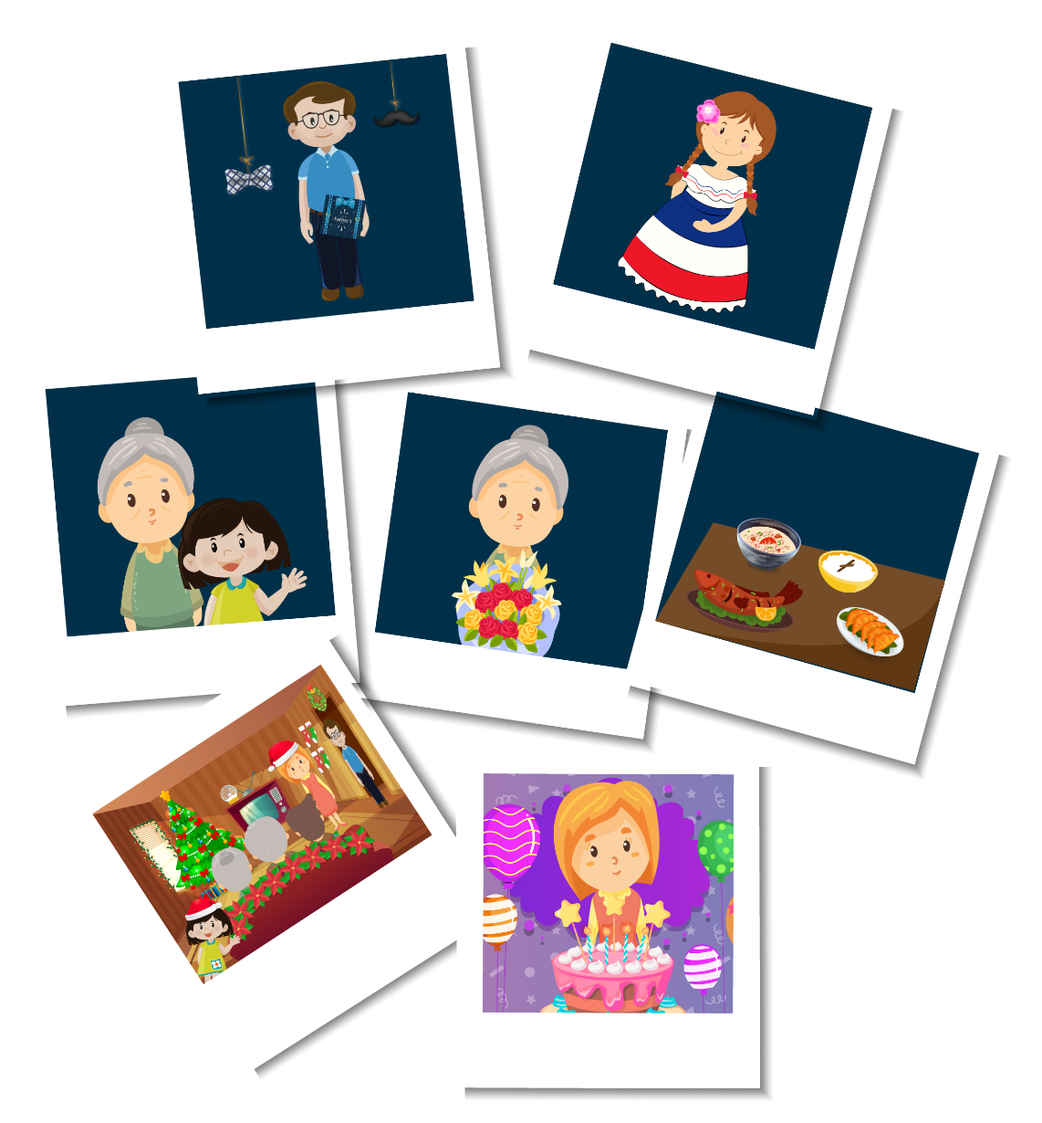
Family Celebrations in Costa Rica Mini Book
My tita Ana loves family celebrations. She enjoys birthdays,Christmas, Holy Week, New Year´s day, Mother´s day, Father´s day and Independence day.

Slide 5
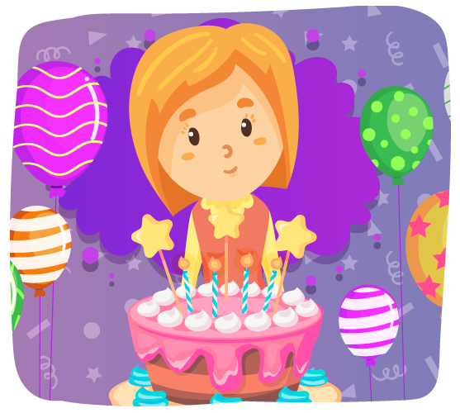
Birthdays
We are celebrating my aunt Lilly´s birthday with a surprise party.
Everybody has a role to do to get ready for the birthday party.

Slide 6
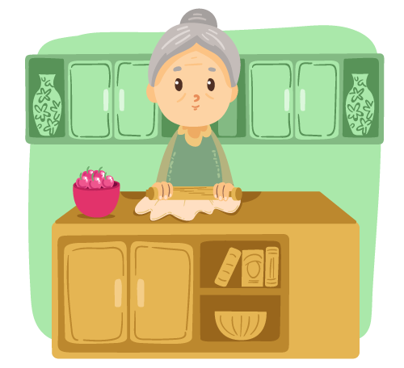
Tita Ana is making rice with chicken, salad and french fries.

Slide 7
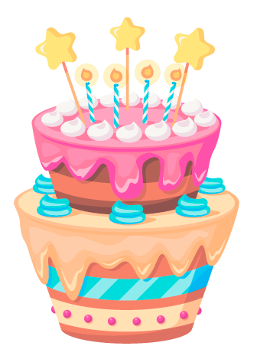
My uncle Minor is buying the cake and candles.

Slide 8

My dad Juan José is going to take pictures and put on some music.

Slide 9
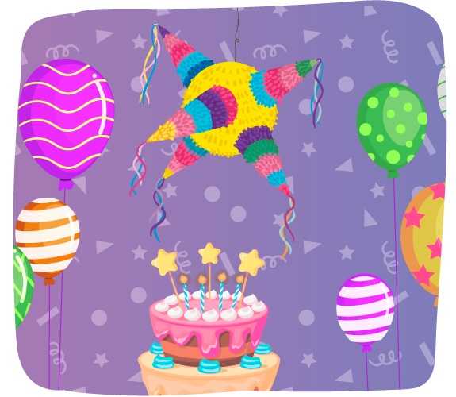
My aunt Yaudy is doing the decoration
with hats, balloons and a piñata.

Slide 10

Tito Alfonso has a nice gift for aunt Lilly.

Slide 11
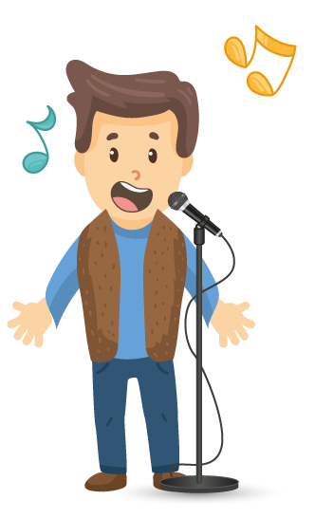
My uncle Helberth is singing karaoke and happy birthday.

Slide 12
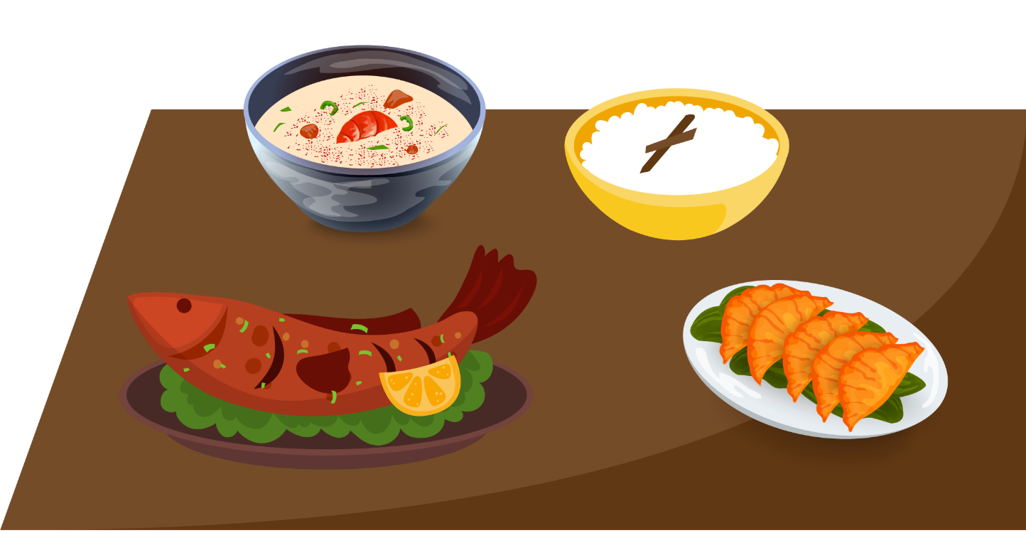
Holy Week
Holy week is tita Ana´s favorite celebration. She loves to cook different dishes such as: rice pudding (arroz con leche), chiverre honey, coconut honey, fish soup, heart of palm (palmito) picadillo.

Slide 13
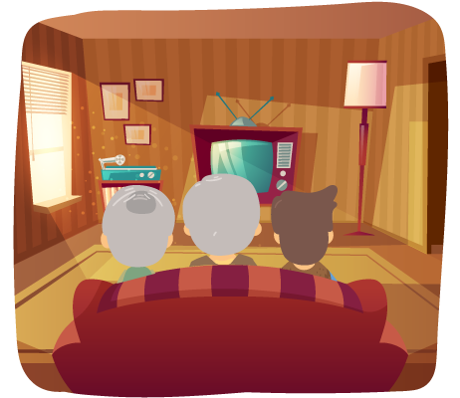
She enjoys seeing all the family eating and watching movies on the television.

Slide 14
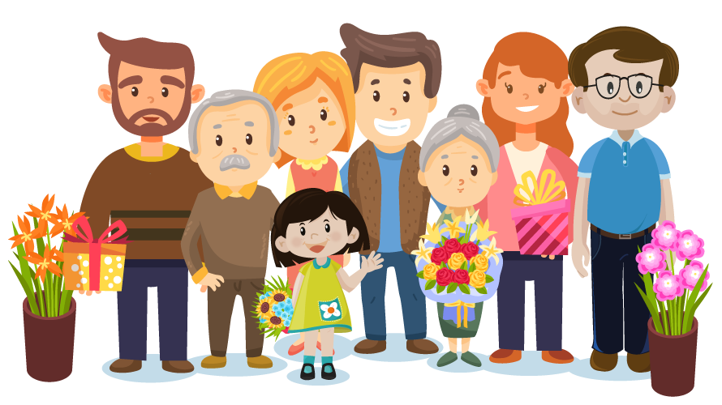
Mother´s Day
On August 15th, Costa Rica celebrates Mother´s day and tita Ana loves this celebration.
The family gets together and brings her flowers and gifts.

Slide 15
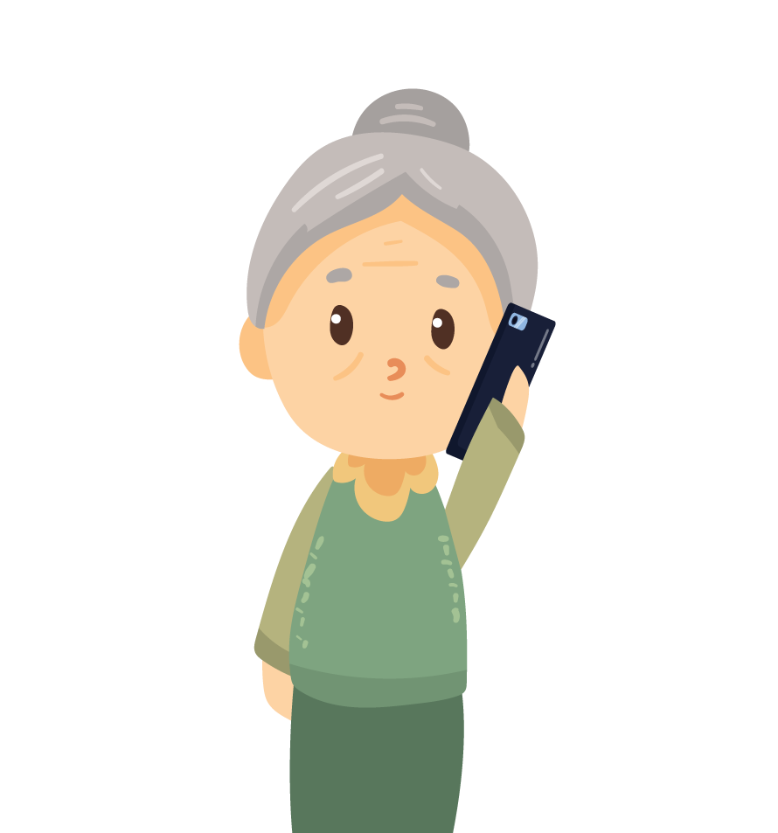
She is very happy because she gets phone calls and cards from friends in the United States.

Slide 16
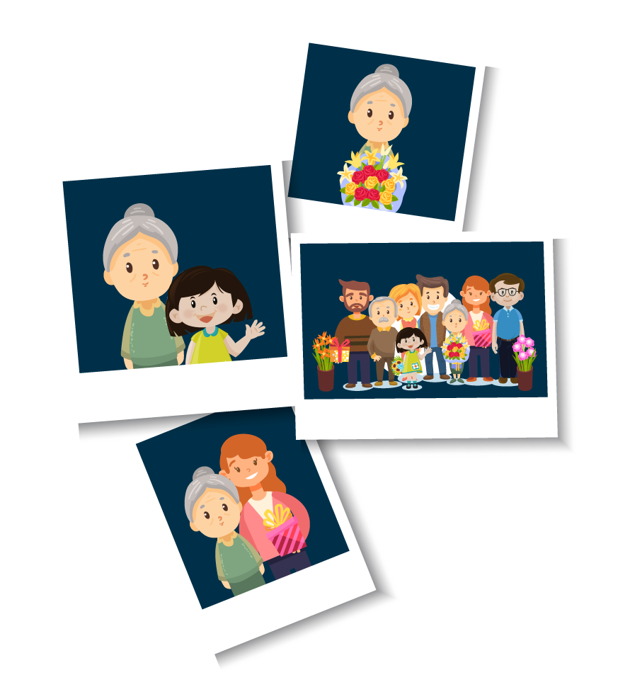
She likes to take pictures to share with her friends and remember the good times.

Slide 17
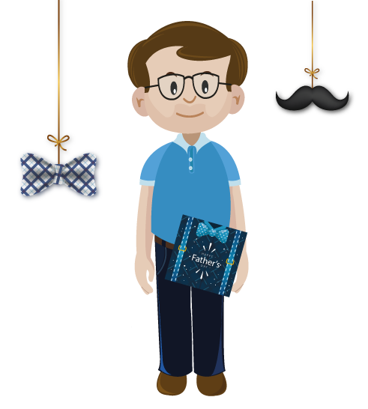
Father´s Day
On Father´s day tita Ana likes to cook a big lunch.
All the children make cards and gifts for all the fathers in the family.

Slide 18
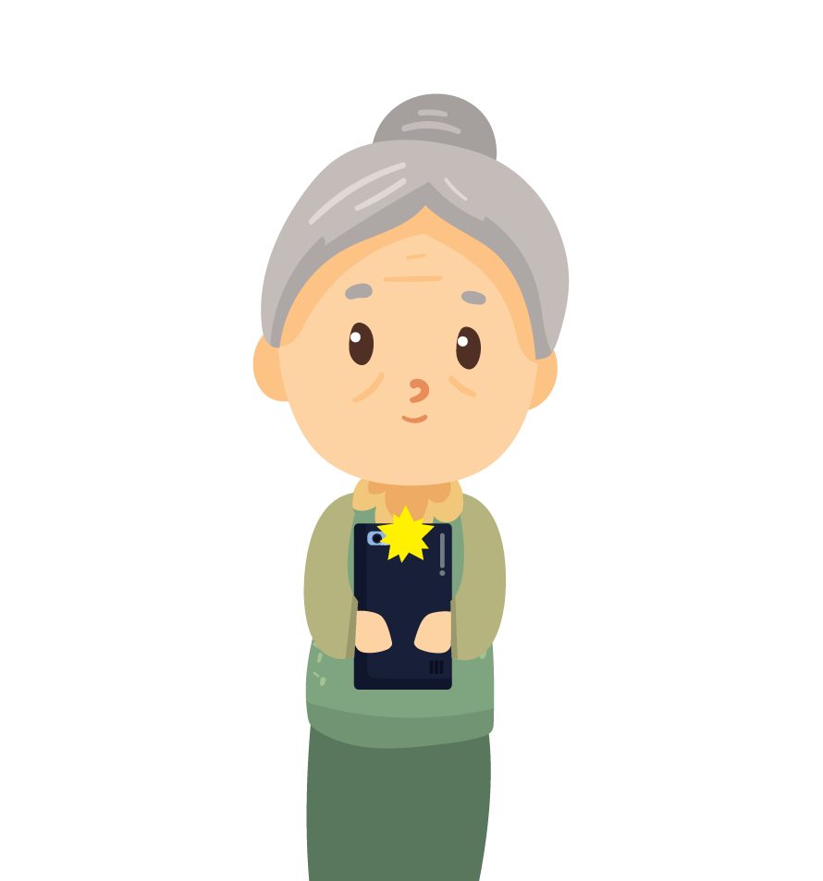
Tita Ana takes pictures of her happy family, laughing and having fun with her cell phone.
Later, she sends messages of unforgettable pictures and new memories.

Slide 19
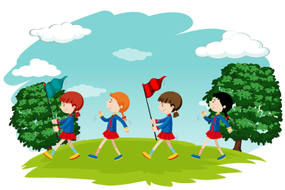
Independence Day
Independence Day in Costa Rica is a big celebration. It is on September 15th.
Tita Ana likes to see the parades.

Slide 20
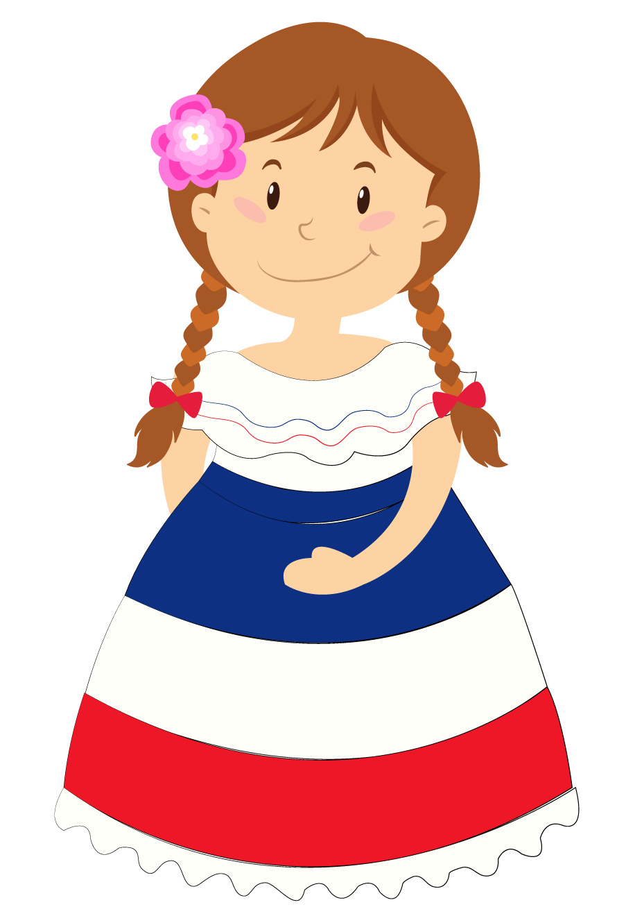
She also takes pictures of me wearing the typical dress she made.

Slide 21
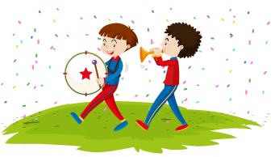
She enjoys watching the typical dances and listening to the bands playing typical music.

Slide 22
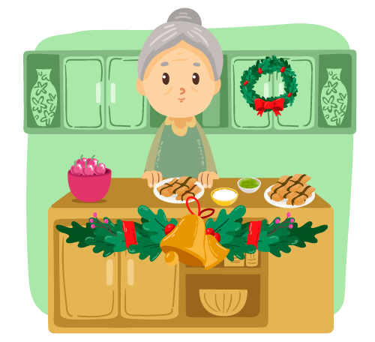
Christmas
At Christmas time my tita likes to make tamales and everybody in the family can help.

Slide 23
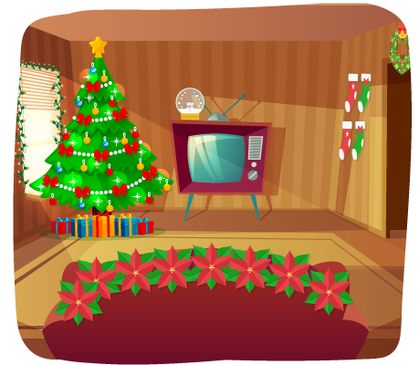
My aunt Lilly enjoys decorating the house and putting gifts under the tree.

Slide 24
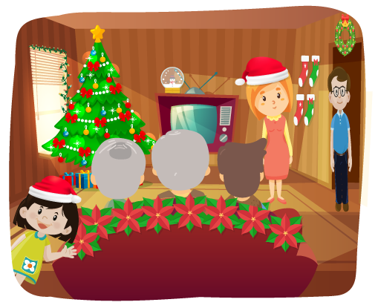
On Christmas Eve, we sing Christmas songs. We have a family dinner and exchange gifts.

Slide 25

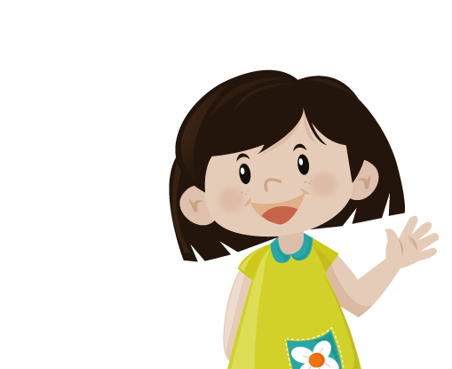

Slide 26
